Slide 1
The Colonial Capital in Africa

Slide 2
The capital of many African colonies became the primate city in the urban network
The capital was the center of administration within a colony, reinforcing its position as the top of the urban hierarchy.
The economic prominence of the capital was apparent

Slide 3
The location of Capitals
Capitals were chosen in two ways
They were established during the pre-1870 era
The military setup the location during their occupation of the area
The majority of capitals were located on the coast because coastal locations allowed easier communication and contact with the colonizing country in Europe
Trade posts and supply points fostered prior to any formal commitment to the colony became capitals once European control was established.
Some colonial capitals, such as Algiers, Algeria, were indigenous capitals of the pre-colonial state.

Slide 4
The prestigious capital
The selection of a site for the capital was of paramount importance:
→Senior administrators were to live in the capital
→A disproportionate portion of the colonial budget was spent in the city
→Costal ports were key shipment locations that became headquarters of most trading companies.
These trends reinforced the supremacy of the capital to lesser cities in the colony.

Slide 5
The moving colonial capital
Once the colonial regime was established the coastal capital were moved in favor of locations in the interior.
Coastal locations were believed to be unhealthy
For example, the British moved the capital of Kenya from the coastal location of Mombasa to Nairobi because the new location was inland and elevated.

Slide 6
Landlocked Colonies
In landlocked colonies pre-colonial capitals, such as Bamako, Uganda, continued to function after European control.
In cases where no pre-colonial capital was in existence, the entry point from where occupation was initiated became the capital. The entry point was commonly located on a river.
For example, Livingstone on the Zambezi River became the capital of Northern Rhodesia.

Slide 7
Capitals in southern Africa
Capitals in southern African were located according to the needs of the rural colonial population, not the desires of the colonizing country.
The settlers established their own governments and administrative capitals as they continued to move further into the interior of the continent from the Cape of Good Hope.
Cities such as Pretoria continued to function as an administrative headquarters. Other cities were only temporary capitals as they lost their political and administrative functions.
In southern Africa coastal sites as locations for colonial capitals were discouraged because the settlers continued to move inland.

Slide 8
Federal Capitals
The location of a federal capital attempted to maintain balance within the federal system.
Federations were colonies grouped together by the colonizing country (metropole) as an attempt to ease the administrative and governmental tasks of dealing with each colony individually.
Federations grouped colonies in the same geographic region together.
French West Africa, the first federation in Africa, had its colony located at Dakar in 1896 (the new major port). Dakar was picked instead of the Senegalese capital of St Louis
Generally, the capital of the most influential colony in the federation was selected to be the federal capital as well.
An interesting case occurred inn South Africa which decided to compromise by keeping three colonial capitals as the capitals of the union formed in 1910.
New capitals were not created to function as the federal capital, pre-existing cities were favored.

Slide 9
The Primate City
Political and economic concentration in the colonial capital led to the growth of the city at the price of other towns.
By the end of the colonial period only three countries in Africa where the capital was not the largest city. This resulted when the capital and primate city were close enough in proximity to operate as a single unit.
Major pre-colonial cities not chosen as the colonial capital shrank in relation to the capital
→For instance, Mombasa (existing city) was 2.5x larger than Nairobi (colonial capital); however, by 1960 Mombasa was only 2/3 the size of Nairobi.

Slide 10
The poorly developed urban network in Africa
In most colonies the largest town was only a fraction of the size of the capital
This reflected the undeveloped urban system in Africa as well as the concentration of functions in the colonial capital.
Leopoldville illustrates the prominence of the colonial capital. As the capital of the Belgian Congo the city rapidly grew from 5,000 in 1908 to 420,000 by the end of the colonial era.

Slide 11
Recent Trends in Urbanizing Africa
Even after the end of the colonial era and the independence of African countries, the Capital continues to function as a primate city situated at the top of the urban network.
The continuing trend of rural-urban migration in African has only reinforced the capital’s position of prominence.
Africa is experiencing the greatest rate of urbanization of any continent on earth.
This can be attributed to rural poverty that has pushed many rural Africans to cities.
Structural adjustment policies have forced African governments to cut back on supplying seeds or other forms of help to farmers.
African farmers have to compete with international products that are sold for less; therefore, the small African farmer cannot compete.
The rapid rates of urbanization has also exacerbated the high rates of HIV/AIDS in Africa, especially in sub-Saharan Africa. Africa has a higher prevalence of AIDS than any another continent.

Slide 12
The plans of the colonial capital
The design of colonial capitals reflected the European country that created it as well as the time period in which it was designed.
Prior to 1850 capitals exhibited constrained designs; however, after 1850 capitals were designed to be larger.
British capitals reflect the garden design (low density housing of single family home surrounded by a garden with curving streets). Many British capitals followed the designs of New Delhi, the great administrative capital of India. British capitals followed the country mansion model like in Nairobi.
The design of French capitals were much more rigid and followed the Parisian model (see module for the North African Colonial City). The French attempted to create an urban setting.

Slide 13
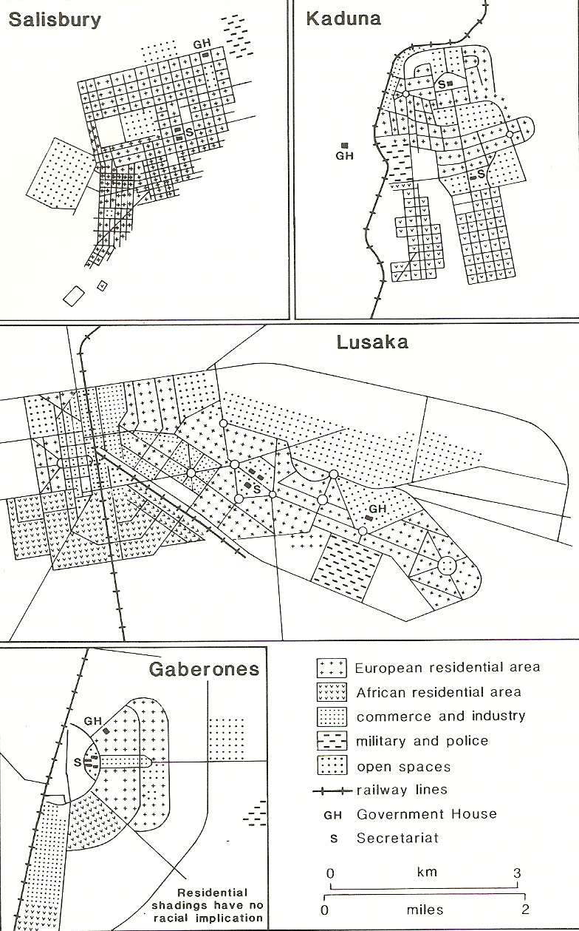
Plans of Colonial capitals
Salisbury (1890) exhibits a grid plan
Lusaka (1934) has a geometrical design
Gaberone (1963) demonstrates the apex of metropolitan design
All three of these capitals were fostered by the British

Slide 14
The distinct capital as a reflection of the metropole
Each colonial power tried to create a distinctively French, British, German or Portuguese variation of the African colonial government building.
Portugal and France attempted to maintain tight control over the daily administration of their empires. This meant that many official involved in African affairs remaining in Lisbon or Paris to bolster the colonial ministries. In the British colonies where self-government was common there was many more officials in the colonial capital; therefore, the British constructed more government buildings.
The British included rose gardens in many of their colonies
The Portuguese created black and white stone paved walkways and squares in their capitals.

